Slide 1
DAA MINI PROJECT
DIVIDE AND CONQUER
TEAM MEMBERS:
SEETHAMSETTI SRIKANTH- RA2011042010088
BIJJAM VISWANATH REDDY- RA2011042010092

Slide 2
Divide-and-Conquer
The most-well known algorithm design strategy:
Divide instance of problem into two or more smaller instances
Solve smaller instances recursively
Obtain solution to original (larger) instance by combining these solutions
Distinction between divide and conquer and decrease and conquer is somewhat vague. Dec/con typically does not solve both subproblems.

Slide 3
Divide-and-Conquer Technique (cont.)
a problem of size n
subproblem 1
of size n/2
subproblem 2
of size n/2
a solution to
subproblem 1
a solution to
subproblem 2
a solution to
the original problem

Slide 4
Divide-and-Conquer Examples
Sorting: mergesort and quicksort
Binary tree traversals
Multiplication of large integers
Matrix multiplication: Strassen’s algorithm
Closest-pair and convex-hull algorithms
Binary search: decrease-by-half (or degenerate divide&conq.)

Slide 5
General Divide-and-Conquer Recurrence
T(n) = aT(n/b) + f (n) where f(n) ∈ Θ(n^{d}), d ≥ 0
Master Theorem: If a < b^{d}, T(n) ∈ Θ(n^{d})
If a = b^{d}, T(n) ∈ Θ(n^{d} log n)
If a > b^{d}, T(n) ∈ Θ(n^{log b a} )
Note: The same results hold with O instead of Θ.
Examples: T(n) = 4T(n/2) + n ⇒ T(n) ∈ ?
T(n) = 4T(n/2) + n² ⇒ T(n) ∈ ?
T(n) = 4T(n/2) + n³ ⇒ T(n) ∈ ?

Slide 6
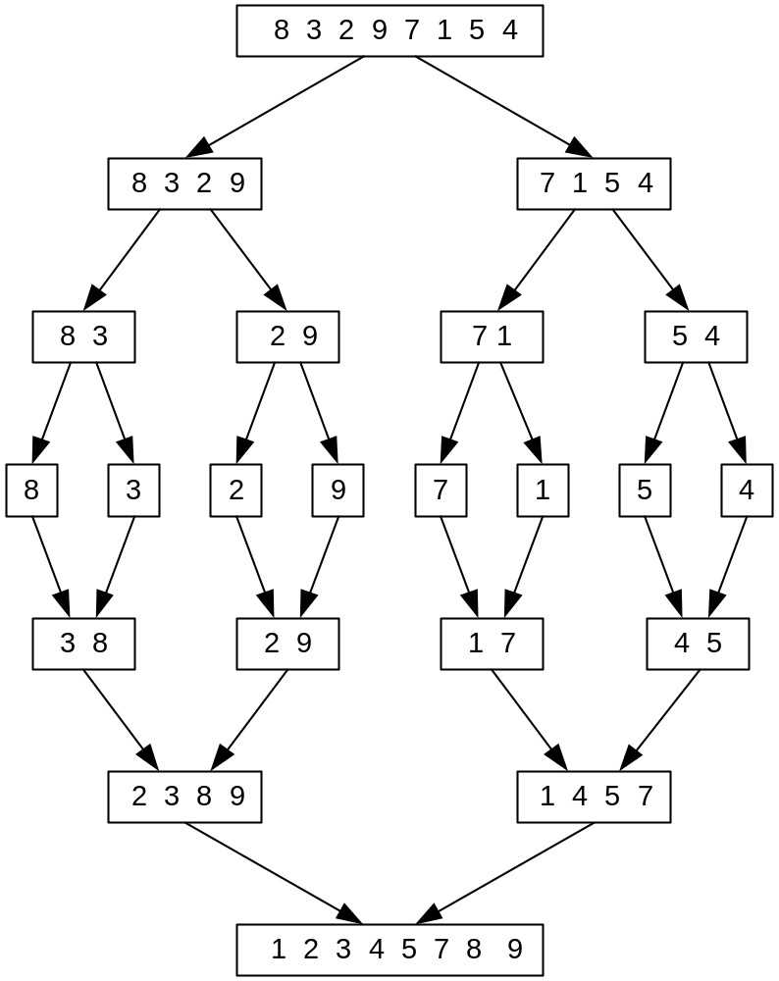
Mergesort Example
Notes:
Go over this example in detail, then do another example of merging, something like:
(1 2 5 7 9)
(3 4 6)

Slide 7
Mergesort
Split array A[0..n-1] in two about equal halves and make copies of each half in arrays B and C
Sort arrays B and C recursively
Merge sorted arrays B and C into array A as follows:
  Repeat the following until no elements remain in one of the arrays:
    compare the first elements in the remaining unprocessed portions of the arrays
    copy the smaller of the two into A, while incrementing the index indicating the unprocessed portion of that array
  Once all elements in one of the arrays are processed, copy the remaining unprocessed elements from the other array into A.

Slide 8
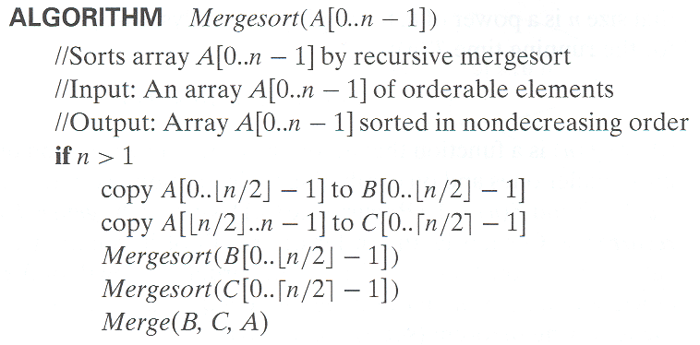
Pseudocode of Mergesort

Slide 9
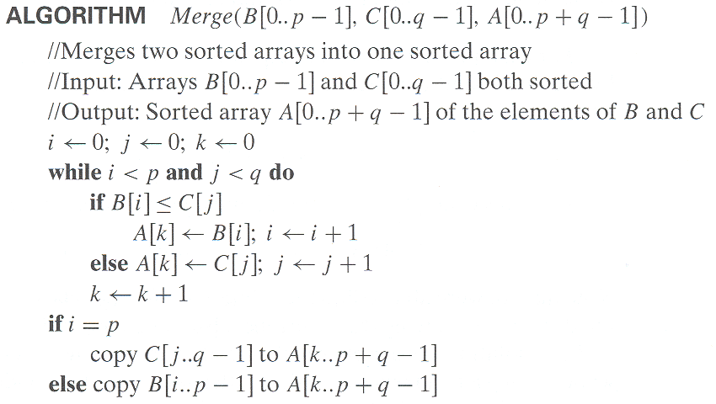
Pseudocode of Merge

Slide 10
Analysis of Mergesort
Number of key comparisons – recurrence:
C(n) = …
For merge step:
C’(n) = …
A. Levitin “Introduction to the Design & Analysis of Algorithms,” 3rd ed., Ch. 5 ©2012 Pearson Education, Inc. Upper Saddle River, NJ. All Rights Reserved.
Notes:
even if not analyzing in detail, show the recurrence for mergesort in worst case:
T(n) = 2 T(n/2) + (n-1)
worst case comparisons for merge

Slide 11
Analysis of Mergesort
Number of key comparisons – recurrence:
C(n) = 2C(n/2) + C’(n) = 2C(n/2) + n-1
For merge step – worst case:
C’(n) = n-1
How to solve?
Number of calls? Number of active calls?
Notes:
even if not analyzing in detail, show the recurrence for mergesort in worst case:
T(n) = 2 T(n/2) + (n-1)
worst case comparisons for merge

Slide 12
General Divide-and-Conquer Recurrence
T(n) = aT(n/b) + f (n) where f(n) ∈ Θ(n^{d}), d ≥ 0
Master Theorem: If a < b^{d}, T(n) ∈ Θ(n^{d})
If a = b^{d}, T(n) ∈ Θ(n^{d} log n)
If a > b^{d}, T(n) ∈ Θ(n^{log b a} )
Using log – Take log _{b} of both sides:
Case 1: log_{b} a < d, T(n) ∈ Θ(n^{d})
Case 2: log_{b} a = d, T(n) ∈ Θ(n^{d} log_{b} n)
Case 3: log_{b} a > d, T(n) ∈ Θ(n^{log b a} )

Slide 13
Analysis of Mergesort
All cases have same efficiency: Θ(n log n)
Number of comparisons in the worst case is close to theoretical minimum for comparison-based sorting:
  - Theoretical min: ⎡log₂ n!⎤ ≈ n log₂ n - 1.44n
Space requirement:
  Book’s algorithm?
Notes:
even if not analyzing in detail, show the recurrence for mergesort in worst case:
T(n) = 2 T(n/2) + (n-1)
worst case comparisons for merge

Slide 14
Analysis of Mergesort
All cases have same efficiency: Θ(n log n)
Number of comparisons in the worst case is close to theoretical minimum for comparison-based sorting:
  - Theoretical min: ⎡log₂ n!⎤ ≈ n log₂ n - 1.44n
Space requirement:
  Book’s algorithm: n + n Sum(1+1/2+1/4+…) = n + n Θ(2)= Θ(3n)
  Can be done Θ(2n) : Don’t copy in sort; just specify bounds, copy into extra array on merge, then copy back
    Any other space required?
  Can be implemented in place. How …
Can be implemented without recursion (bottom-up)
Notes:
even if not analyzing in detail, show the recurrence for mergesort in worst case:
T(n) = 2 T(n/2) + (n-1)
worst case comparisons for merge

Slide 15
Mergesort Example
Notes:
Go over this example in detail, then do another example of merging, something like:
(1 2 5 7 9)
(3 4 6)

